Slide 1
Storage Devices
ICT Lab
CL-1000

Slide 2
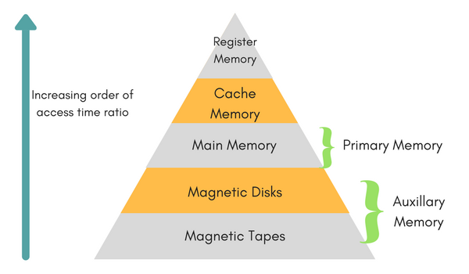
Memory
Memory is used to hold data and software for the processor.
There is a variety of memory types, and often a mix is used within a single system. Some memory will retain its contents while there is no power, yet will be slow to access.
Other memory devices will be high-capacity, yet will require additional support circuitry and will be slower to access.
Still other memory devices will trade capacity for speed, yielding relatively small devices, yet will be capable of keeping up with the fastest of processors.

Slide 3
Storage Structure
Units of storage
Bit and bytes
Kilobyte, Megabyte and Gigabyte
Terabyte and Petabyte
Main memory has program and data accessed by the CPU for execution directly
Volatile and too small to contain all information
Secondary storage solves the problems
Extension of main memory
Store large quantities of information permanently
Storage system is organized in a hierarchy
Varies in speed, capacity, cost and volatility
Notes:
What do the units mean? Main memory cannot hold code and data permanently because of volatility and size.

Slide 4
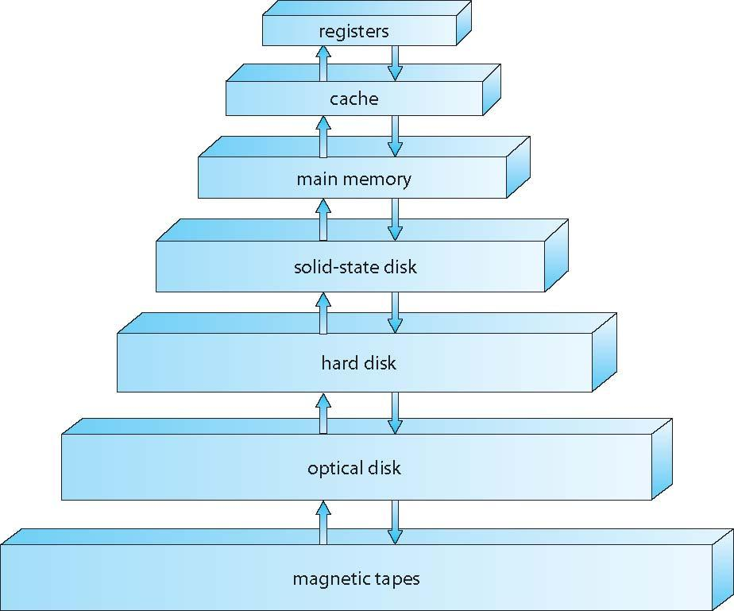
Storage-Device Hierarchy

Slide 5
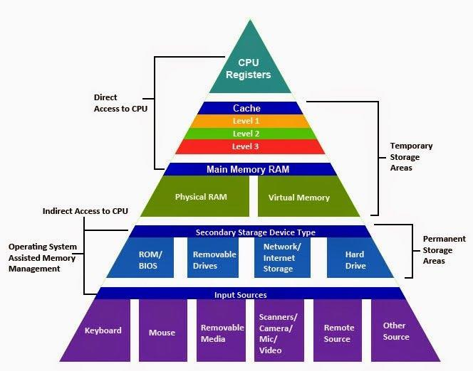
Storage-Device Hierarchy

Slide 6
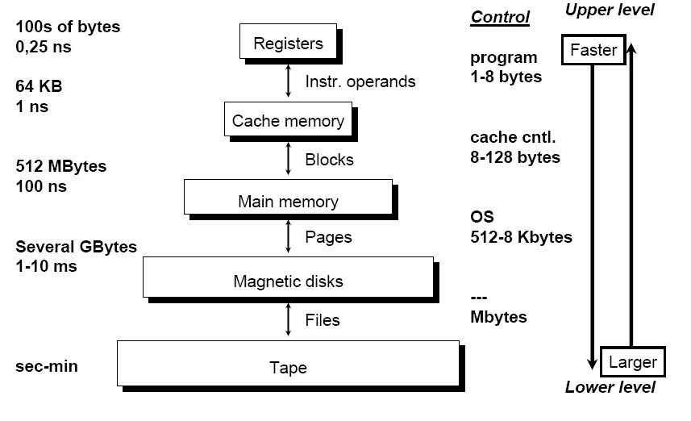
Storage-Device Hierarchy

Slide 7
Storage Structure
Higher to lower levels
Decrease in speed
Increase in size
Decrease in cost
More persistence (non-volatile)
SSDs (Solid Storage Disks) are faster than magnetic disks and are nonvolatile
Flash memory is used in PDAs and other such devices
Design of memory system must balance all factors

Slide 8
Locality of Reference
locality of reference, also known as the principle of locality, is the tendency of a processor to access the same set of memory locations repetitively over a short period of time. There are two basic types of reference locality – temporal and spatial locality.
Temporal locality refers to the reuse of specific data and/or resources within a relatively small time duration.
Spatial locality (also termed data locality) refers to the use of data elements within relatively close storage locations. Sequential locality, a special case of spatial locality, occurs when data elements are arranged and accessed linearly, such as traversing the elements in a one-dimensional array.

Slide 9
RAM (Random Access Memory)
It is where the processor may easily write data for temporary storage. RAM is generally volatile, losing its contents when the system loses power.
SRAM
SRAMs use pairs of logic gates to hold each bit of data. SRAMs are the fastest form of RAM available, require little external support circuitry, and have relatively low power consumption.
Their drawbacks are that their capacity is considerably less than DRAM, while being much more expensive.
DRAM
DRAMs are the highest-capacity memory devices available and come in a wide and diverse variety of subspecies.
Most processors with large address spaces include support for DRAMs.

Slide 10
ROM
ROM stands for Read-Only Memory.
ROMs are nonvolatile memory, requiring no power to retain their contents.
They are generally slower than RAM, and considerably slower than fast static RAM.
The primary purpose of ROM within a system is to hold the code (and sometimes data) that needs to be present at power-up
EPROM
Short for Erasable Programmable Read-Only Memory, EPROM is a non-volatile memory chip that can only be read.
PROM
PROM stands for Programmable Read-Only Memory, during the manufacturing process, a PROM is manufactured in an empty state and then programmed later using a PROM programmer or burner.
EEPROM
EPROM stands for Electrically Erasable Programmable Read-Only Memory, and the distinction between EPROM and EEPROM is that the latter can be erased and written to by the computer system it is installed in.

Slide 11
HDD v/s SSD
A hard disk drive (HDD) is a traditional storage device that uses mechanical platters and a moving read/write head to access data.
A solid state drive (SSD) is a newer, faster type of device that stores data on instantly-accessible memory chips.
An HDD is enclosure contains a series of platters covered by a ferromagnetic coating. The direction of the magnetization represents the individual bits. Data is read and written by a head (similar to the way vinyl record albums work) that moves extremely fast from one area of the disk to another. Since all of these pieces are “mechanical,” the hard disk is the slowest component of any computer – and the most fragile.

Slide 12
Continued
These newer types of disks store information on flash memory, which consists of individual memory cells storing bits that are instantly accessible by the controller.
And while hard disks have moving parts, solid state drives are shock-resistant. If you drop your laptop, chances are that the read/write head of an old-school hard drive is in motion, which could lead to data failure. This doesn’t happen with SSDs.
The copying process takes 30-150 MB per second (MB/s), while the same action takes about 500 MB/s on normal SSDs, or even 3,000-3,500 MB/s on newer SSDs

